Slide 1
ONLINE DELIVERY SYSTEM
Presented by: GARlapati Vishnu Babu
Department of Computer Science and Engineering
Sathyabama Institude of Science and Technology
Year: 2025

Slide 2
Abstract
Fresh Cart is a web-based platform that facilitates the delivery of fresh fruits and vegetables directly from local shops to customers in their neighborhood.
The platform empowers local shop owners to register, list their daily produce, set prices, and manage orders, while customers can conveniently browse available items, place orders, and schedule deliveries.
By focusing on locally sourced produce and member-driven delivery, Fresh Cart ensures freshness, affordability, and supports small businesses.
This initiative promotes healthy eating, reduces dependency on large retailers, and fosters a strong community network through an easy-to-use, efficient online marketplace.

Slide 3
Existing System
Traditional purchase of groceries and vegetables is done manually from local markets.
Customers need to physically visit shops to check product availability and prices.
There is no unified platform connecting customers and small vendors.
Time-consuming process and lack of real-time stock updates.
Limited reach for local shop owners to expand their business.

Slide 4
Proposed System
A web-based platform that connects local vegetable/fruit vendors with customers.
Shop owners can register, upload products, manage inventory, and track orders.
Customers can browse items, place orders, make online payments, and track deliveries.
Real-time updates of stock, pricing, and delivery status.
Focus on local sourcing, freshness, and community growth.

Slide 5
Advantages
Provides doorstep delivery of fresh produce.
Saves time and effort for customers.
Promotes local business growth and economic sustainability.
Real-time tracking of orders and stock management.
Ensures transparency in pricing and product availability.
Eco-friendly and community-centered initiative.

Slide 6
Disadvantages
Requires internet access for both customers and vendors.
Delivery delays possible during high demand or poor weather.
Maintenance and technical issues may affect service temporarily.
Limited to specific local areas during initial stages.

Slide 7
Hardware Requirements
Component | Specification
Processor | Intel Core i3 or above
RAM | Minimum 4 GB
Hard Disk | 250 GB or above
Display | 1024x768 resolution
Internet | Stable broadband or Wi-Fi connection

Slide 8
Software Requirements
Component | Specification
Frontend | HTML, CSS, JavaScript, React/Angular
Backend | Java, Spring Boot / Node.js / Python Django
Database | MySQL / MongoDB
Web Server | Apache / Tomcat
Tools | VS Code / Eclipse / IntelliJ
OS | Windows / Linux / macOS
Browser | Google Chrome / Edge / Firefox

Slide 9
Modules
User Module – For customer registration, login, browsing, and ordering.
Vendor Module – For shop registration, listing products, and managing inventory.
Admin Module – For system management, verifying shops, and monitoring activities.
Order Module – For managing customer orders, delivery scheduling, and payment tracking.
Payment Module – For secure online payments and transaction history.
Delivery Module – For assigning and tracking delivery personnel.

Slide 10
Module Description
1. User Module: Allows customers to register, log in, browse produce, and place orders. Users can also view past orders and track ongoing deliveries.
2. Vendor Module: Vendors can add or update their products, manage prices, check incoming orders, and confirm dispatch.
3. Admin Module: Admin oversees platform activities, verifies vendor accounts, and handles reports or disputes.
4. Order Module: Handles order creation, order status updates (Pending, Confirmed, Delivered), and notifications.
5. Payment Module: Supports multiple payment methods such as UPI, Credit/Debit cards, and Cash on Delivery.
6. Delivery Module: Ensures the right delivery personnel are assigned and provides real-time tracking for customers.

Slide 11
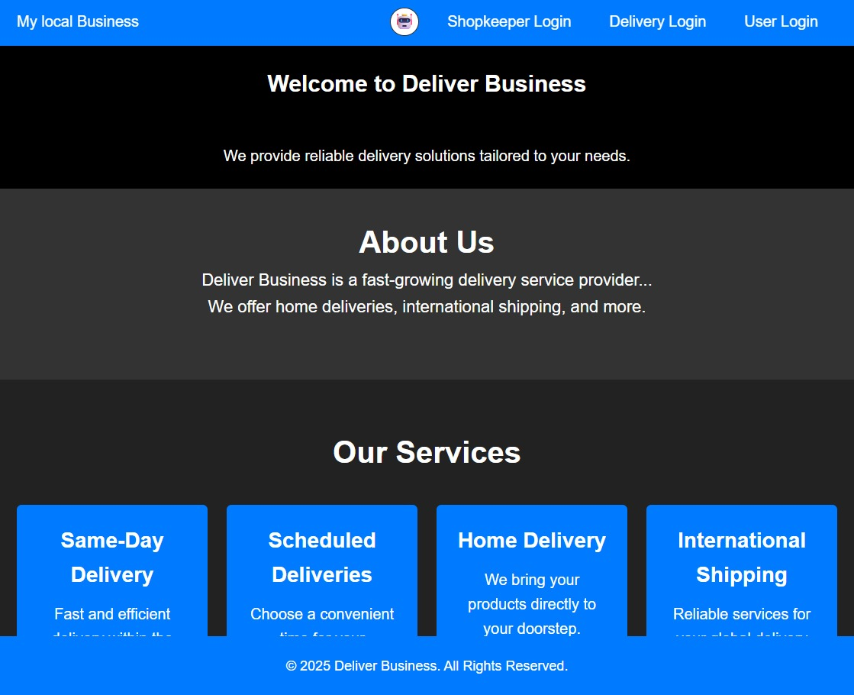
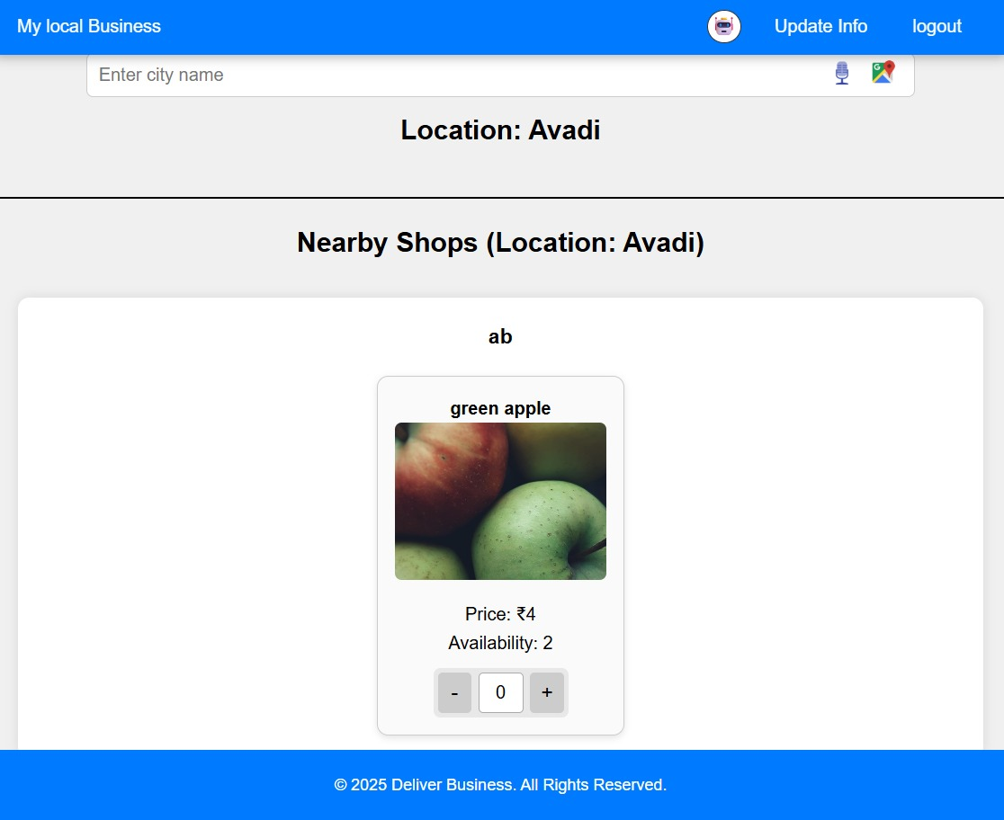
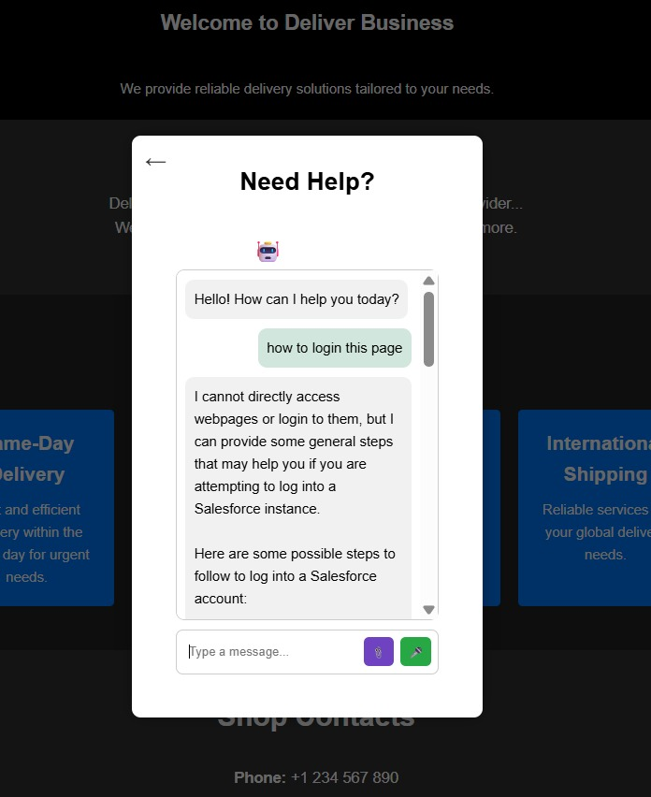
Sample Output (Screenshot)

Slide 12
Conclusion
Fresh Cart bridges the gap between customers and local vendors by offering a reliable, efficient, and user-friendly online delivery platform. It encourages local economic growth, provides healthy and fresh food choices, and leverages technology to simplify daily grocery shopping. Through Fresh Cart, users experience convenience, transparency, and freshness all in one place.

